Slide 1

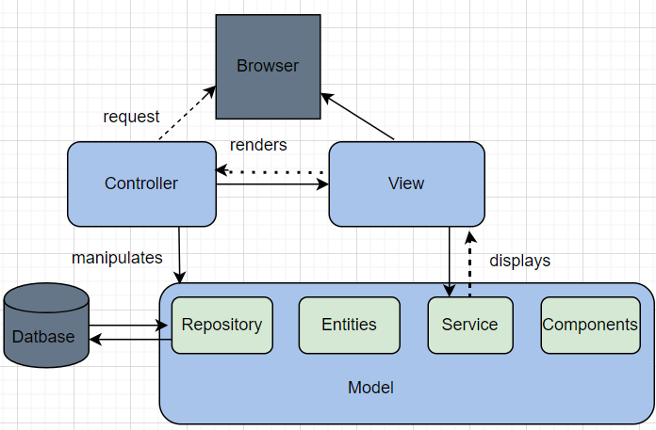
Enterprise Software Frameworks for Festival R Us
Introduction
Results:
Ethical and legal obligations
Businesses like Festivals R Us, a ticket sales system, must provide a seamless and secure user experience. Users should be able to access the system using different types of devices. The user should connect with the application effortlessly and securely across all devices. The devices serve as a key point for the user to view events, order tickets, and make payments. Security methods such as encryption, authentication, and secure payment processing must be implemented.
Architecture and scalability:
It uses microservices architecture that allows services like payments, events listing, and ticket inventory to run independently. (Atlassian, 2025)
It ensures high performance and uptime by scaling individual services based on demand.
Security and Data Handling:
It supports the use of spring security, OAuth2, HTTPS, and JWT.
It enables secure payment handling and user authentication and is critical for GDPR compliance. (GeeksforGeeks, 2024)
Cross-Device Compatibility:
RESTful APIs seamless integration with web apps, mobile Apps, and kiosk and POS system
Cloud Ready:
Works well in cloud platforms (AWS, Azure).
Supports containerisation like Docker and Kubernetes
GDPR Compliance
All data from the user must be stored securely and processed with consent.
Must provide opt-in/opt-out mechanisms and support data erasure requests. (gov.ie 2020)
Ethical Payment Processing. (Fruhlinger, 2024)
The use of PCI-DSS compliance gateways is mandatory.
Data encryption in transit and at rest must be enforced
Accessibility and Fair Use.
UI/UX must support accessibility standards.
The algorithm used for ticket allocation must be transparent and non-discriminatory.
Security by design
Regular penetration testing and audit logging
A secure development lifecycle must be followed (“About Secure by Design” 2023)
Methods:
Spring Framework:
Robust with spring security, integrates with OAuth2, JWT
Highly scalable; mostly used in distributed systems
Rest APIs allow multiple device integration.
Big ecosystem, enterprise-ready, and excellent community.
Django framework
Built-in protection against SQL, CSRF injection, and XSS
Suitable for mid-sized application
The REST framework supports APIs across devices.
rapid development, batteries included, readable syntax
Not suitable for enterprise-grade applications. (linkedin.com 2024)
.NET Core:
It has enterprise-grade security features, including identity and role-based authentication.
Highly scalable and optimized for cloud-based deployment.
Web API and Blazor support multiple devices.
Has strong performance and support from Microsoft.
Conclusion:
The Spring framework's Microservices Architecture and MVC model are suitable for the "Festivals R Us" ticket sales application. It ensures scalability, security, flexibility, and availability, which are critical for high-volume transactions. By complying with GDPR and PCI DSS, the platform will protect user privacy, meet regulatory obligations, and maintain consumer trust while providing a secure, efficient user experience across multiple devices.
References
“.NET Cloud Applications with Azure | Build and Consume Cloud Services.” Microsoft, 2025, dotnet.microsoft.com/en-us/apps/cloud/azure.[Accessed 5 Apr. 2025]
.“About Secure by Design.” UK Government Security - Beta, 8 Nov. 2024, www.security.gov.uk/policy-and-guidance/secure-by-design/about/[Accessed 31.March 2025]
Atlassian “Microservices Architecture.” Atlassian, 2025, www.atlassian.com/microservices/microservices-architecture.[Accessed 05 Apr. 2025]
chloe, and chloe. “Implementing Role-Based Access Control (RBAC) in Your Backend.” Moments Log, 18 Sept. 2023, www.momentslog.com/development/web-backend/implementing-role-based-access-control-rbac-in-your-backend. [Accessed 6 Apr. 2025.]
Cross-Platform App Development Frameworks, Strategies, and Best Practices | Iterators. 29 Mar. 2024, www.iteratorshq.com/blog/cross-platform-app-development-frameworks-strategies-and-best-practices/.{Accessed 05 Apr. 2025]
Fruhlinger, Josh. “PCI DSS Explained: Requirements, Fines, and Steps to Compliance.” CSO Online, 3 Apr. 2024, www.csoonline.com/article/569591/pci-dss-explained-requirements-fines-and-steps-to-compliance.html.[Accessed 04 Apr. 2025]
GeeksforGeeks. “Spring Security Tutorial.” GeeksforGeeks, 16 May 2024, www.geeksforgeeks.org/spring-security-tutorial/#prerequisites-for-spring-security.[Accessed 05 Apr. 2025]
gov.ie. “Data Protection and the General Data Protection Regulation (GDPR).” Www.gov.ie, 21 Jan. 2020, www.gov.ie/en/organisation-information/26c38c-data-protection-and-the-general-data-protection-regulation-gdpr/.“[Accessed 04 Apr. 2025.]
Introduction to Spring Framework: Java Enterprise Development.” Clouddevs.com, 10 June 2019, clouddevs.com/java/spring-framework/.[Accessed 6 Apr. 2025.]
Learn about the Benefits and Features of Six Frameworks That Are Widely Used in Enterprise Software Development, such as Java EE, .NET, Spring, Django, Laravel, and Ruby on Rails.” Linkedin.com, 4 Mar. 2024, www.linkedin.com/advice/1/youre-interested-enterprise-software-what-most-5tdnf. [Accessed 30 Mar. 2025.“]
What Is Spring Framework, and Why Should It Be Used for Web Application Development?” RABILOO CO., LTD, 2025, rabiloo.com/blog/what-is-spring-framework-and-why-should-it-be-used-for-web-application-development.[Accessed 6 Apr. 2025.]
Fig. 1 shows how MVC works and Architecture (Yeran Kods, 2023)
Recommendations
Mapping Processes
User Sign-Up/Login: Auth through OAuth2-JWT issued -Session initialized.
Event Listing: Frontend request event data through REST- Microservices fetches and returns the data.
Ticket Purchase: Secure payment microservice invoked - Payment confirmed - Ticket generated.
Admin Interface: Secure backend interface with RBAC for event organisers. (chloe and chloe 2023)
For “Festival R Us,” Spring framework Architecture is recommended according to (“Introduction to Spring Framework: Java Enterprise Development” 2019 ) as it uses a modular approach, and it allows the components to be integrated and configured.
¹ Name: Caroline Iheanacho 2022503

